Slide 1
Introduction to Deep Neural Network

Slide 2
Machine Learning Basics
Machine learning is a field of computer science that gives computers the ability to learn without being explicitly programmed
Labeled Data
Machine Learning algorithm
Training
Prediction
Labeled Data
Learned model
Prediction
Methods that can learn from and make predictions on data

Slide 3
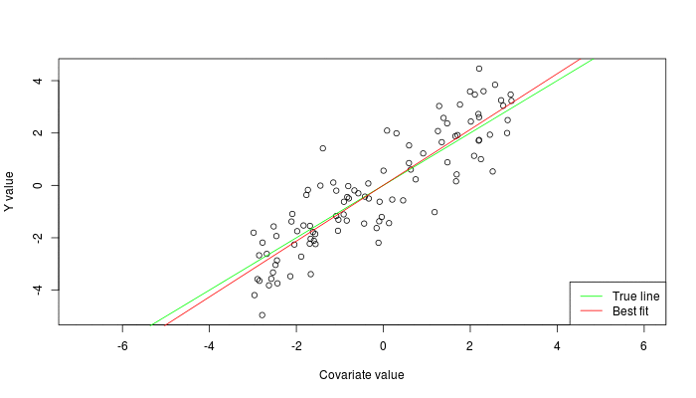


Types of Learning
Supervised: Learning with a labeled training set
Example: email classification with already labeled emails
Unsupervised: Discover patterns in unlabeled data
Example: cluster similar documents based on text
Reinforcement learning: learn to act based on feedback/reward
Example: learn to play Go, reward: win or lose
class A
class A
Classification
Regression
Clustering
Anomaly Detection
Sequence labeling
…
http://mbjoseph.github.io/2013/11/27/measure.html

Slide 4
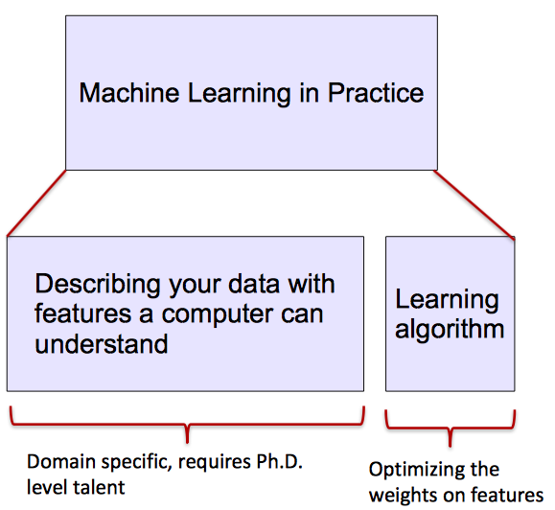
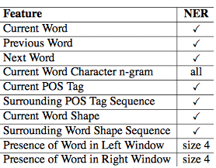
ML vs. Deep Learning
Most machine learning methods work well because of human-designed representations and input features
ML becomes just optimizing weights to best make a final prediction

Slide 5

What is Deep Learning (DL) ?
A machine learning subfield of learning representations of data. Exceptional effective at learning patterns.
Deep learning algorithms attempt to learn (multiple levels of) representation by using a hierarchy of multiple layers
If you provide the system tons of information, it begins to understand it and respond in useful ways.
https://www.xenonstack.com/blog/static/public/uploads/media/machine-learning-vs-deep-learning.png

Slide 6
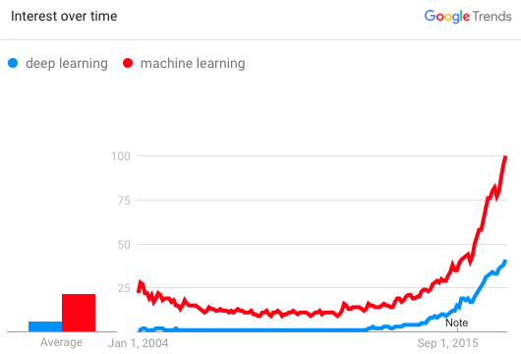
Why is DL useful?
Manually designed features are often over-specified, incomplete and take a long time to design and validate
Learned Features are easy to adapt, fast to learn
Deep learning provides a very flexible, (almost?) universal, learnable framework for representing world, visual and linguistic information.
Can learn both unsupervised and supervised
Effective end-to-end joint system learning
Utilize large amounts of training data
In ~2010 DL started outperforming other ML techniques
first in speech and vision, then NLP

Slide 7
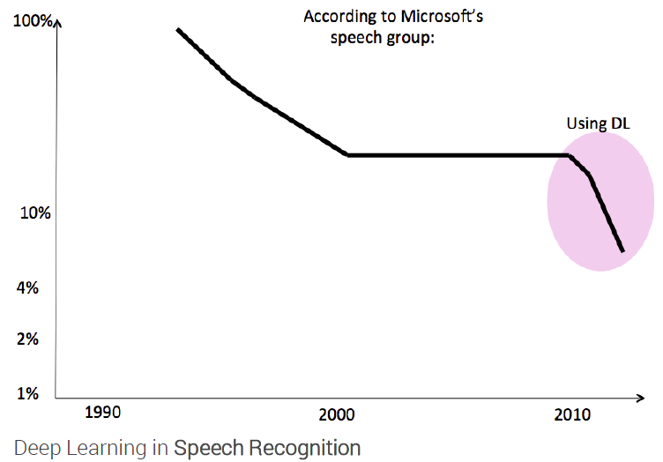
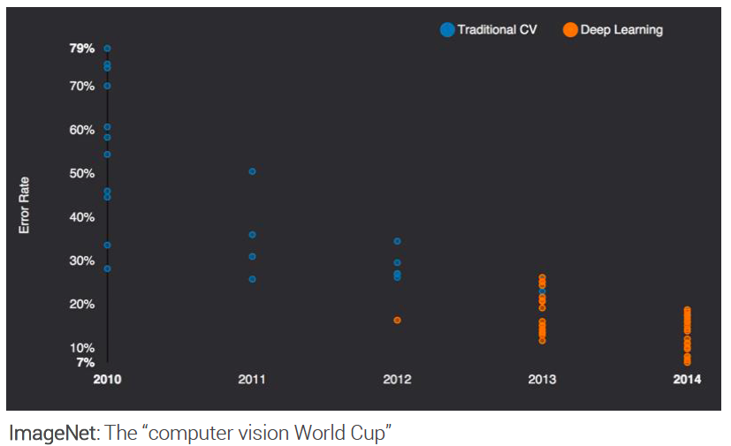
State of the art in …
Several big improvements in recent years in NLP
Machine Translation
Sentiment Analysis
Dialogue Agents
Question Answering
Text Classification …
Leverage different levels of representation
words & characters
syntax & semantics

Slide 8
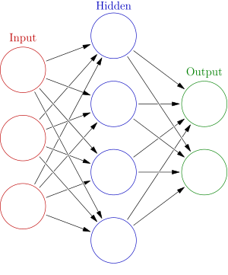


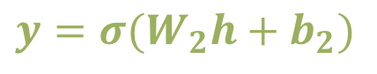
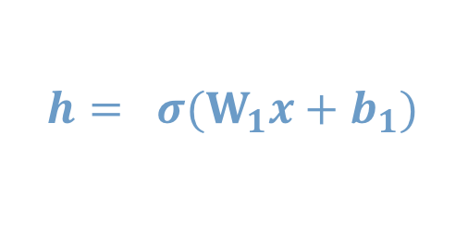
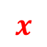
Neural Network Intro
Weights
$$h= σ(W_{1}x+b_{1})$$
$$y=σ(W_{2}h+b_{2})$$
Activation functions
How do we train?
$$y$$
$$x$$
4 + 2 = 6 neurons (not counting inputs)
[3 x 4] + [4 x 2] = 20 weights
4 + 2 = 6 biases
26 learnable parameters
$$h$$
Demo
Notes:
Hyper-parameters

Slide 9
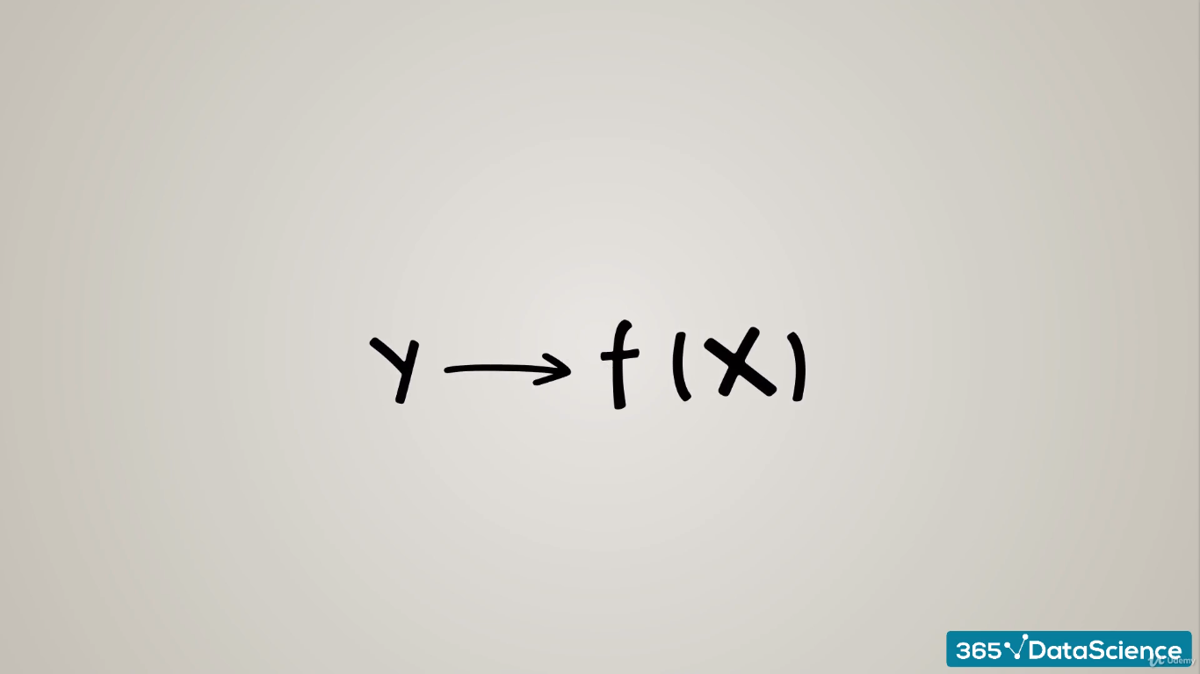

Slide 10
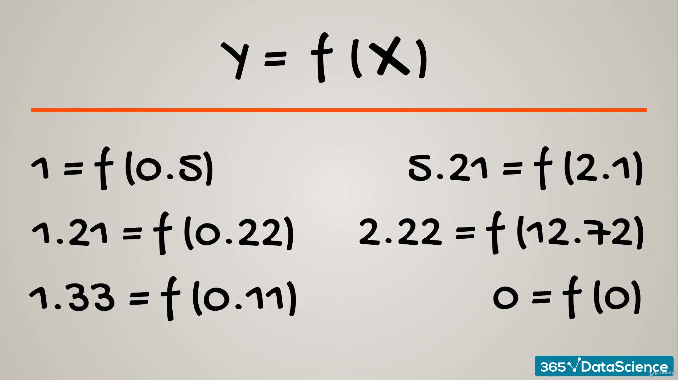

Slide 11
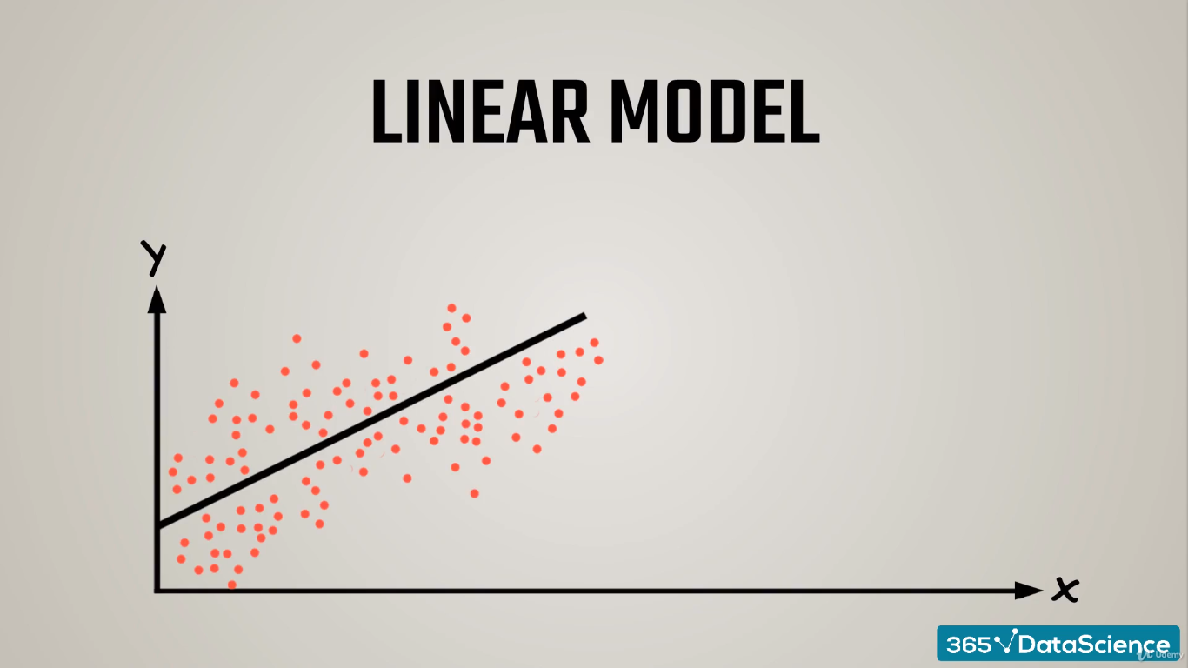

Slide 12
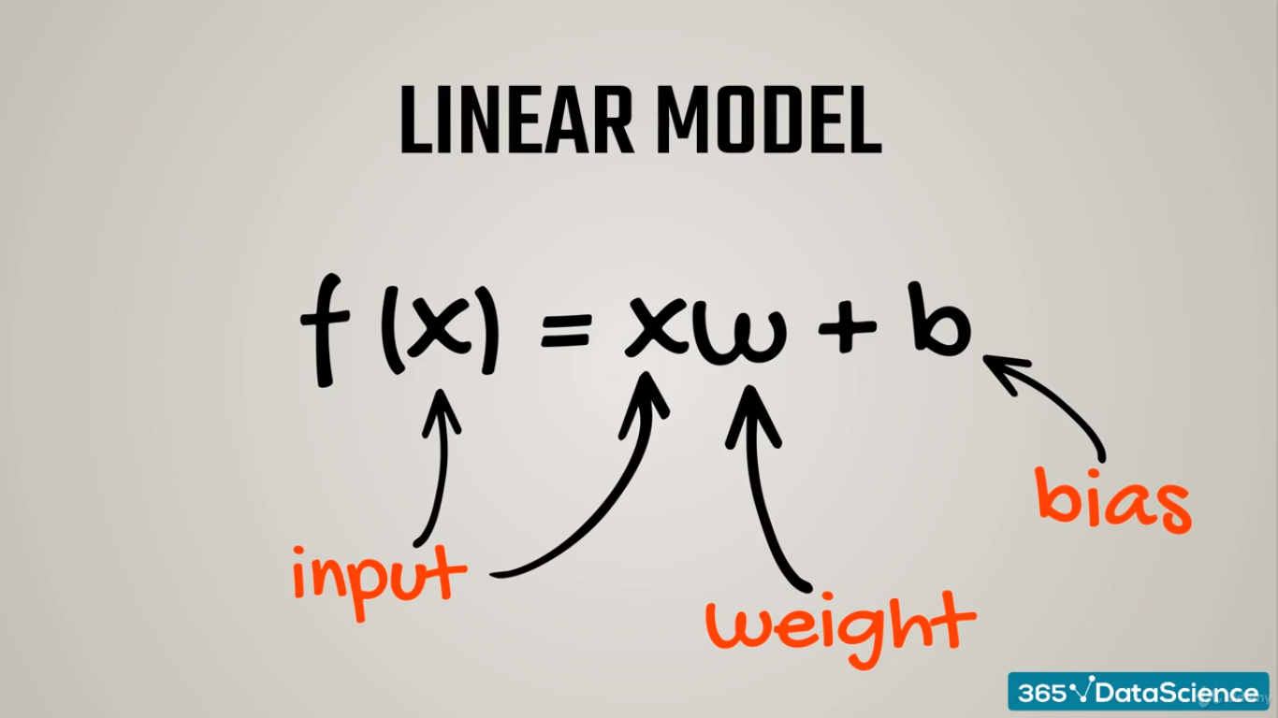

Slide 13
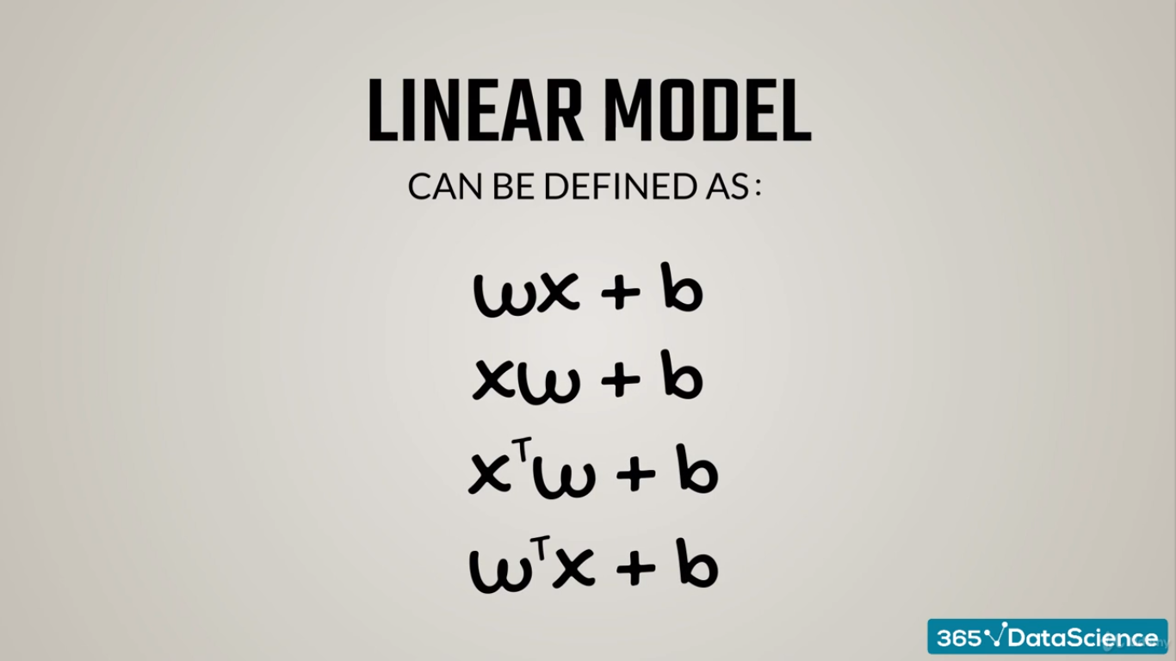

Slide 14
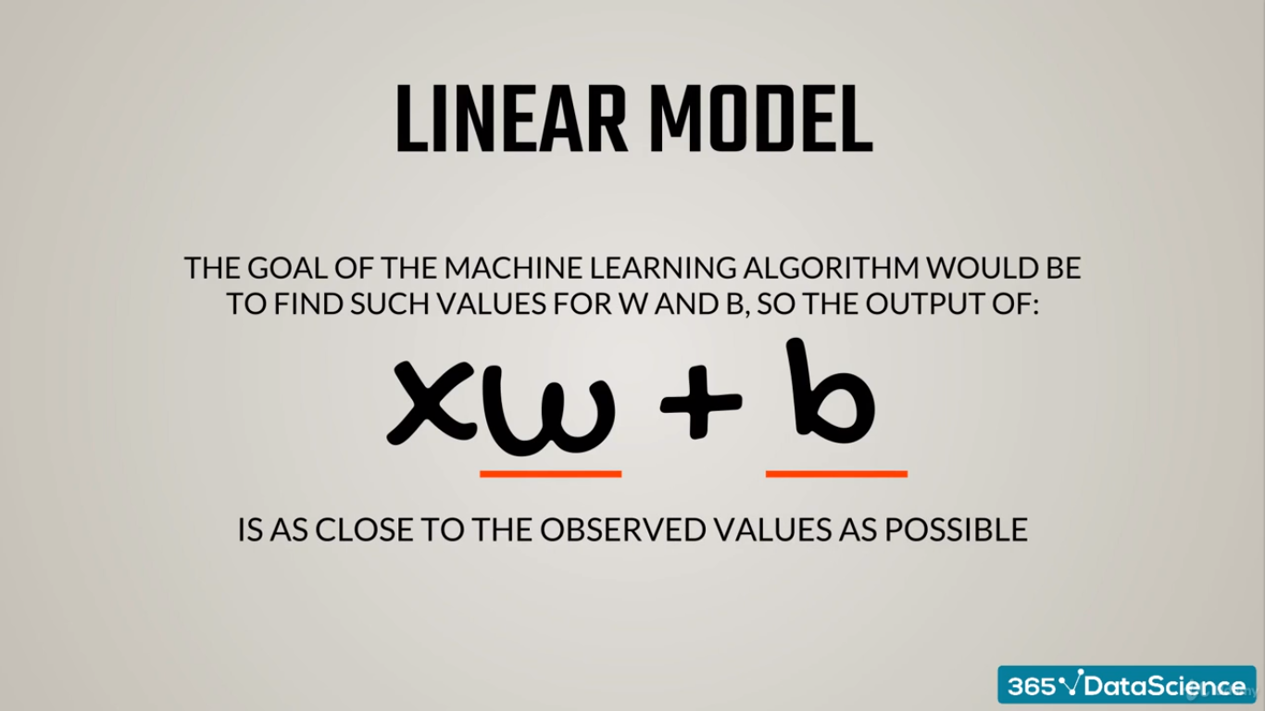

Slide 15
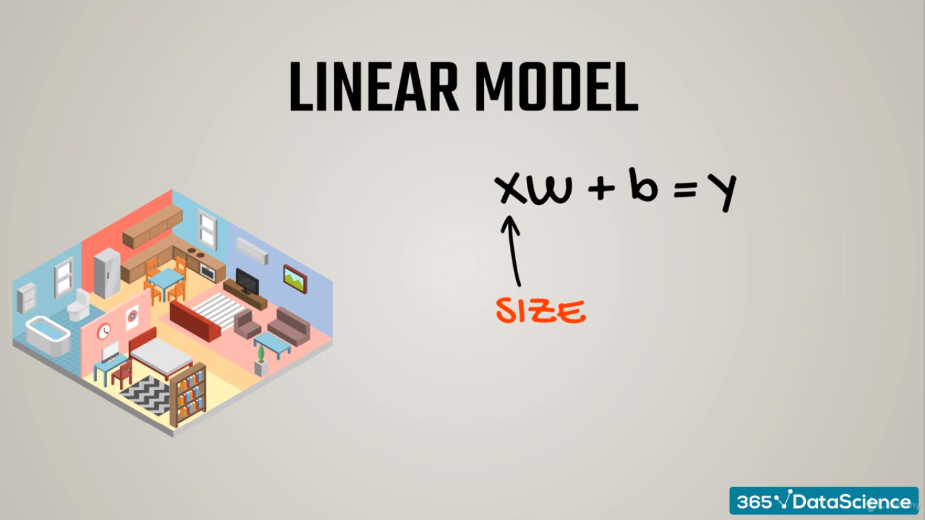

Slide 16
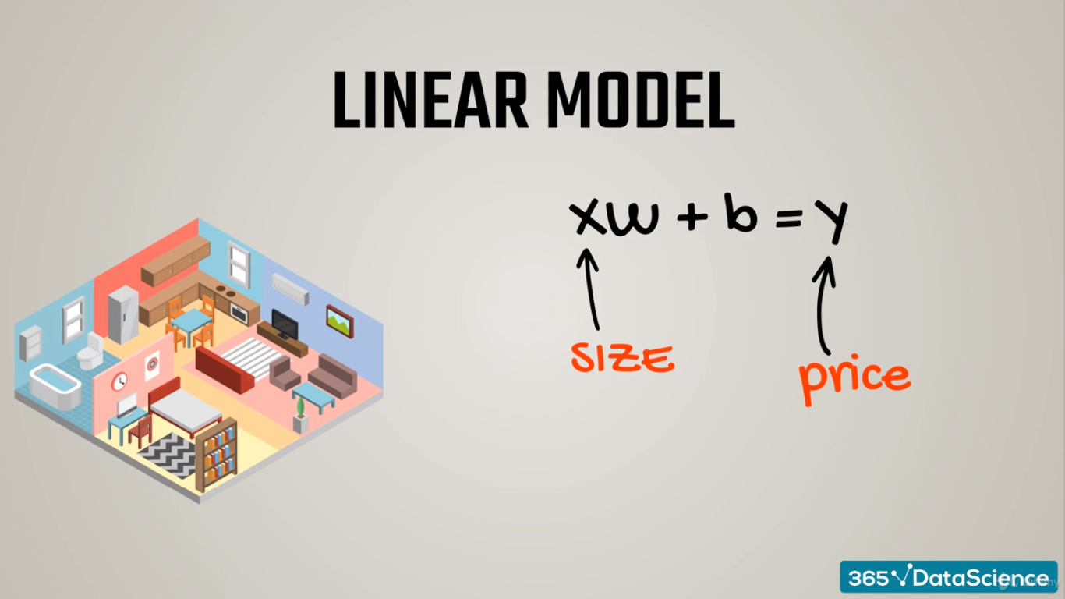

Slide 17
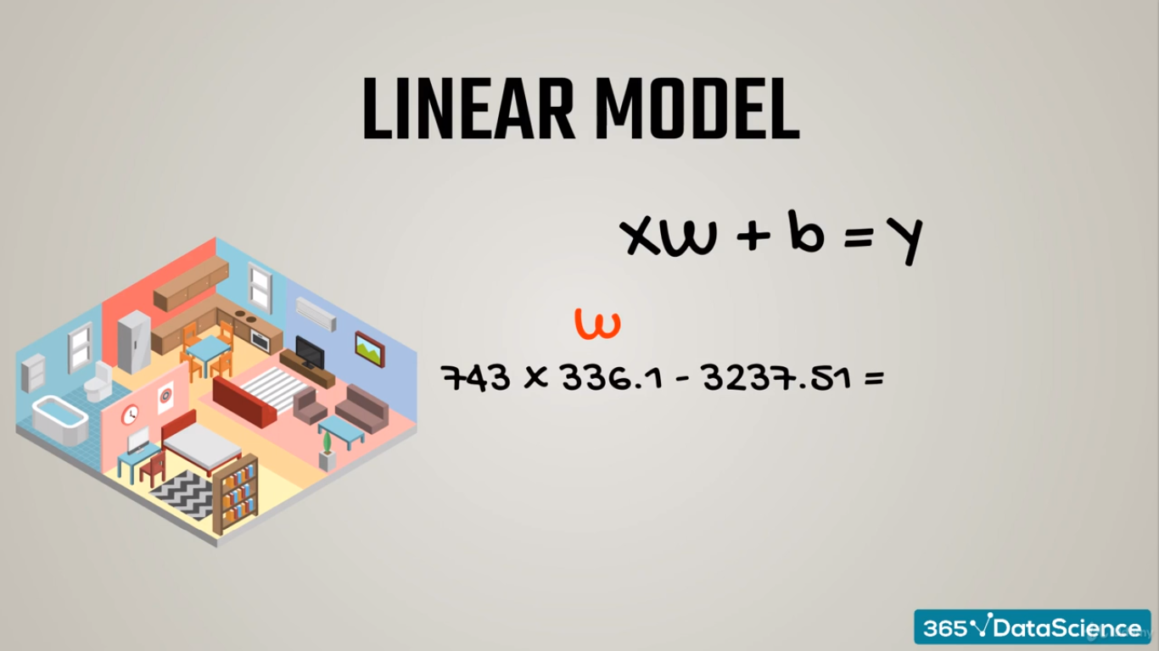

Slide 18


Slide 19
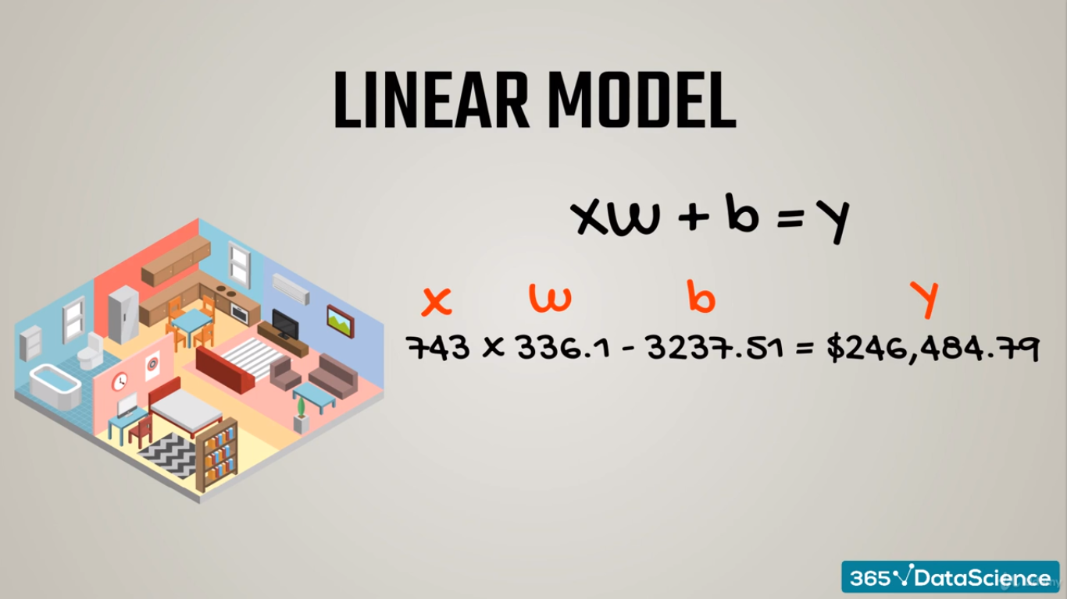

Slide 20
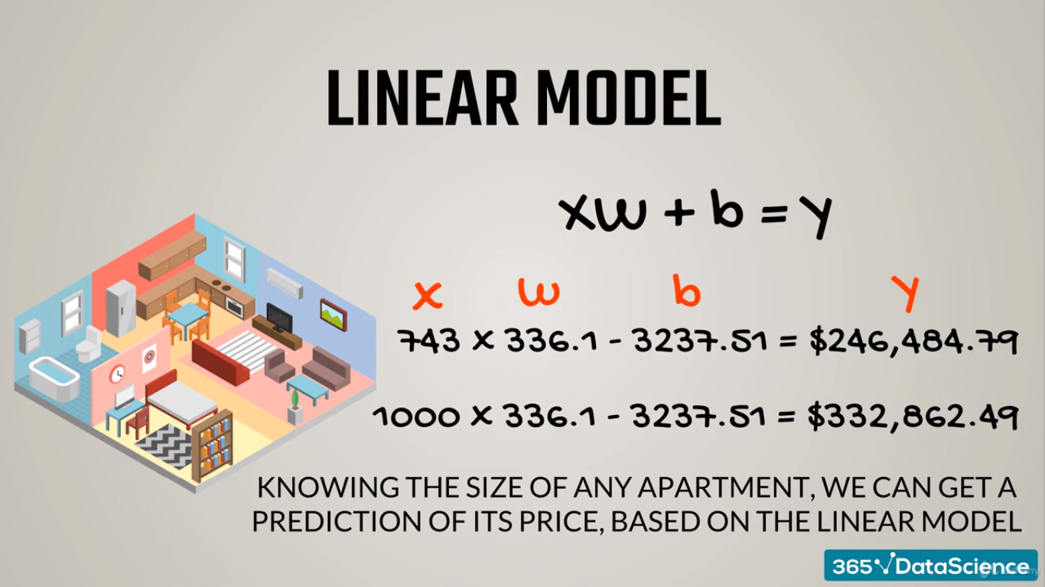

Slide 21


Slide 22
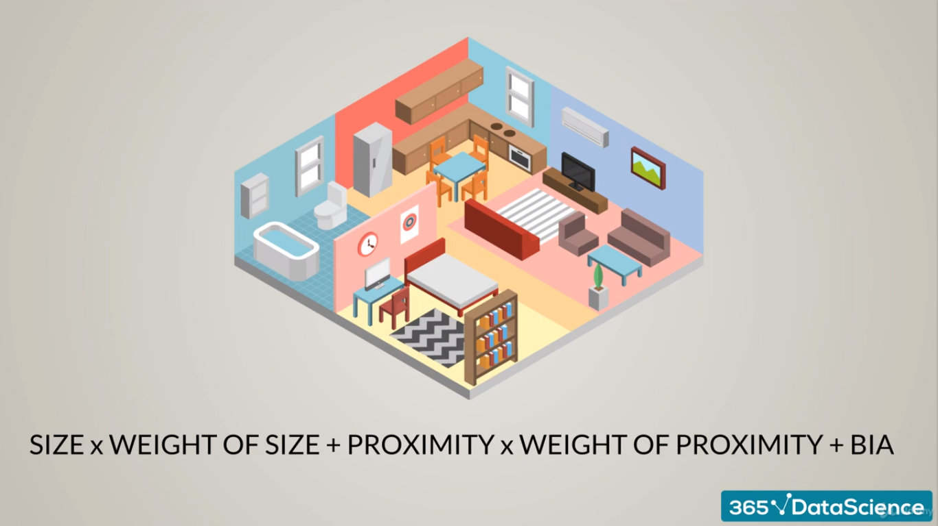

Slide 23
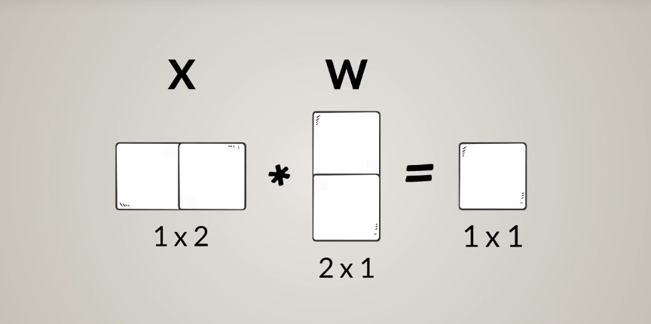

Slide 24
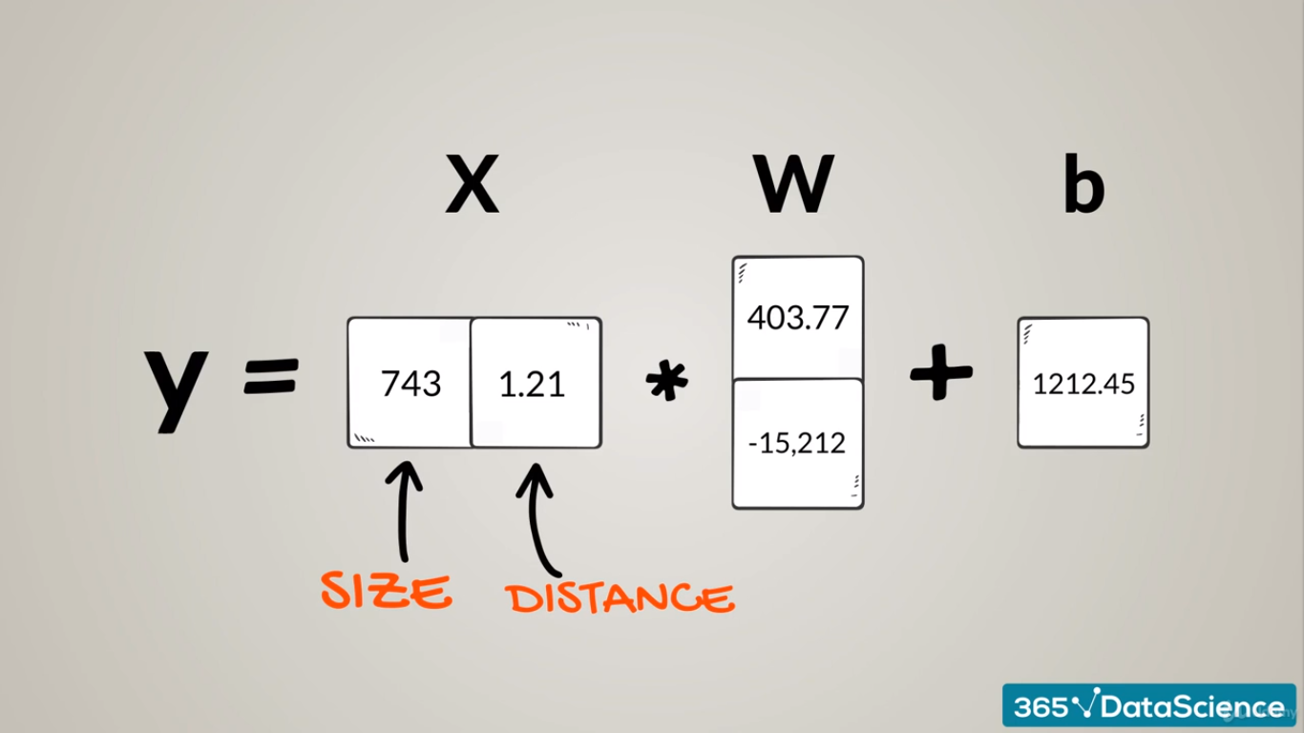

Slide 25
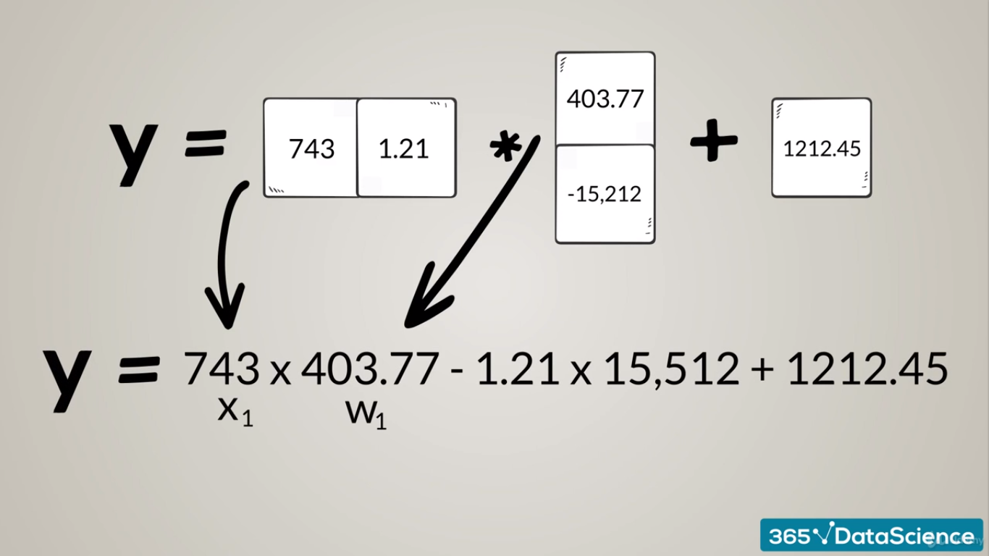

Slide 26
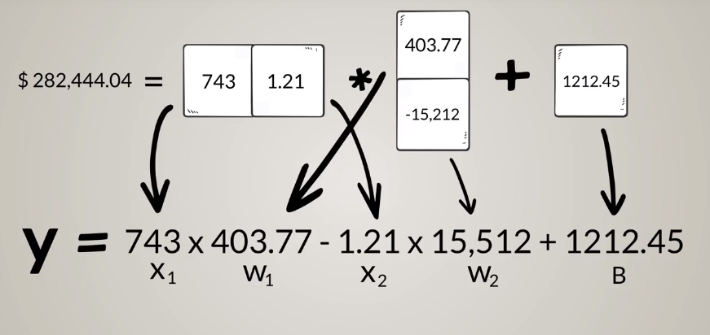

Slide 27
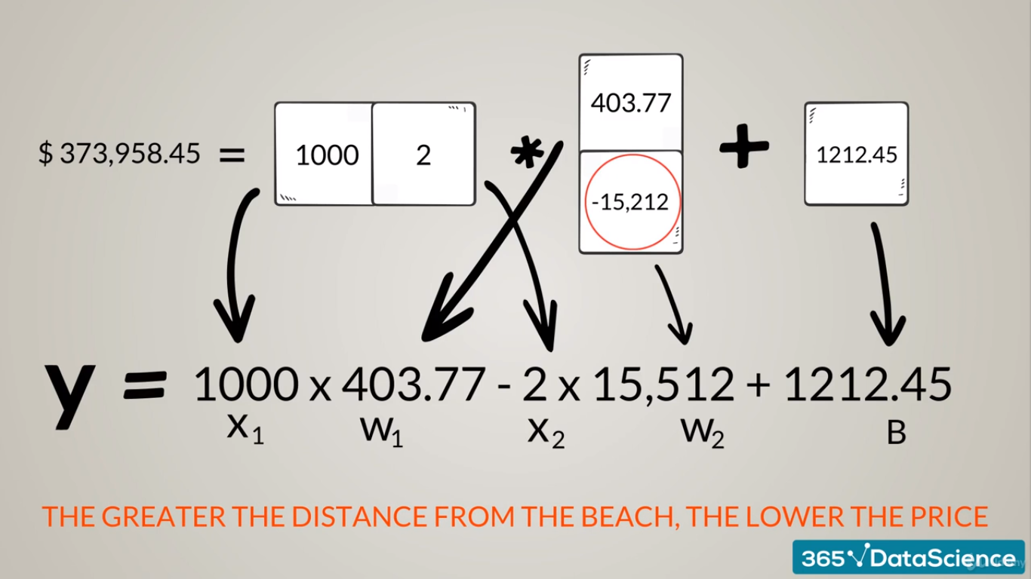

Slide 28


Slide 29
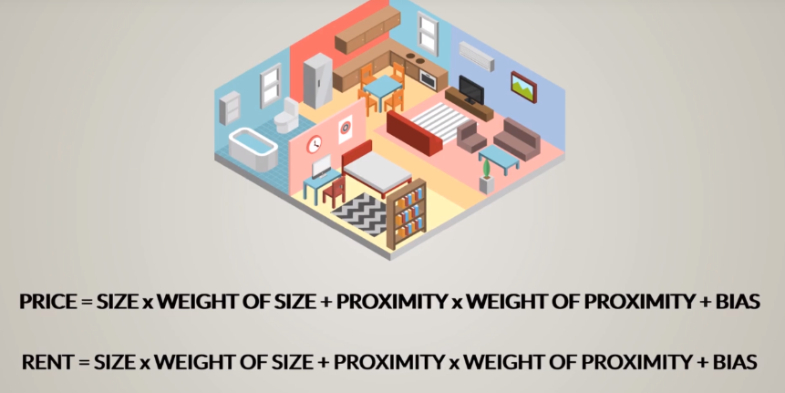

Slide 30
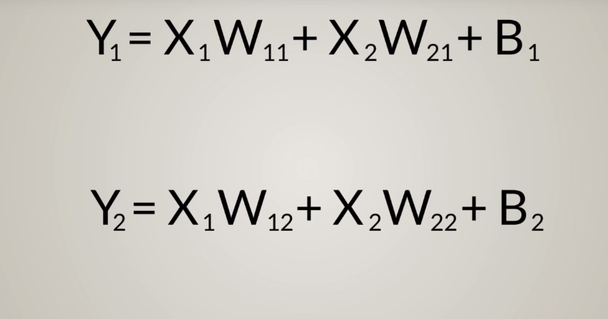

Slide 31
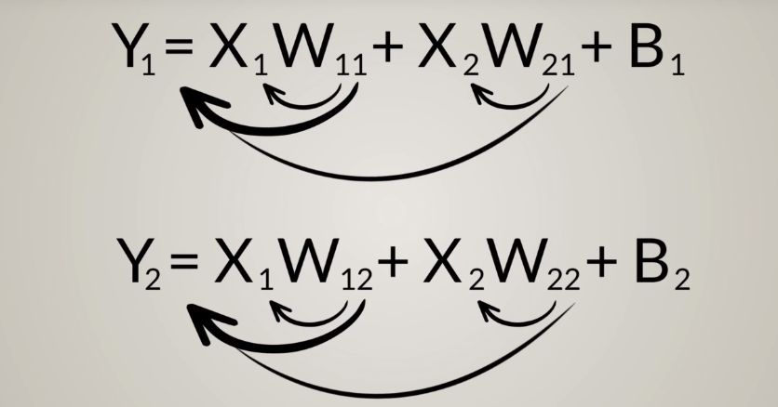

Slide 32
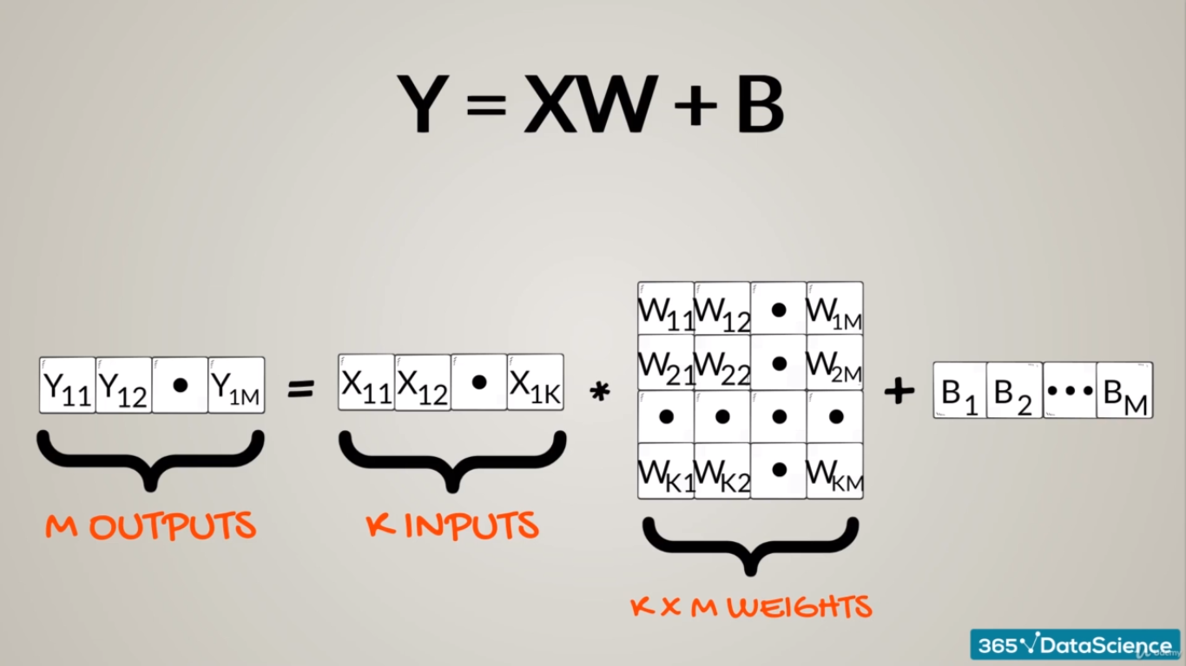

Slide 33
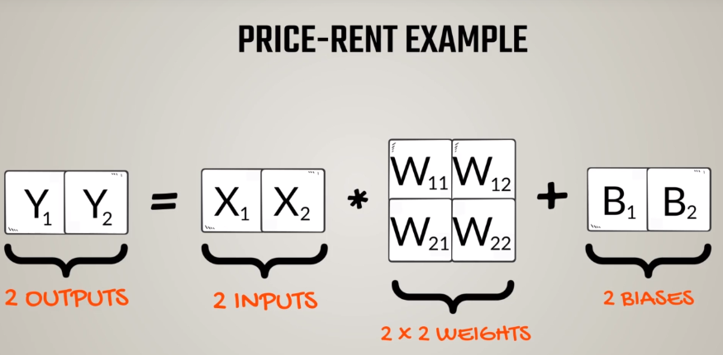

Slide 34
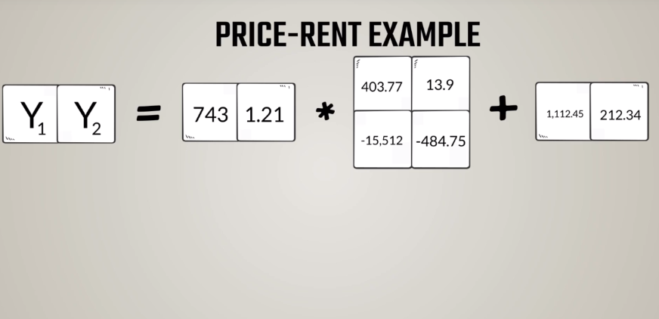

Slide 35
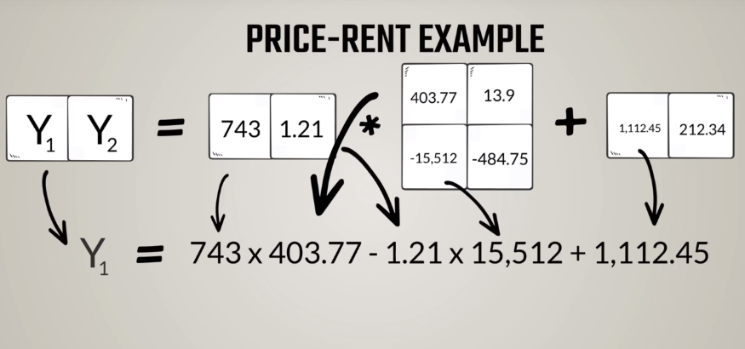

Slide 36
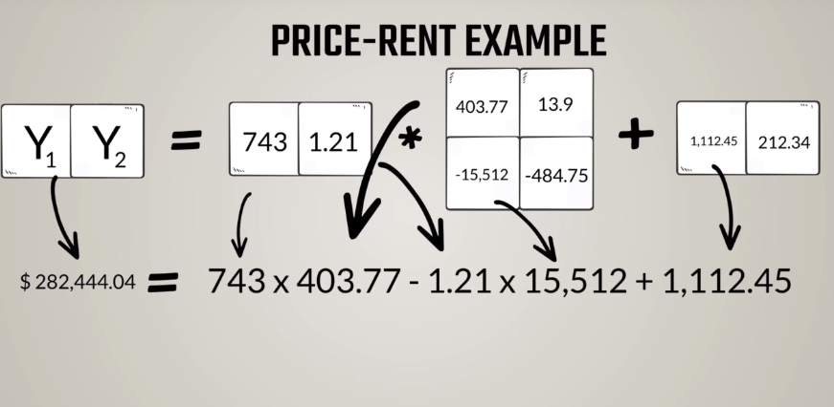

Slide 37
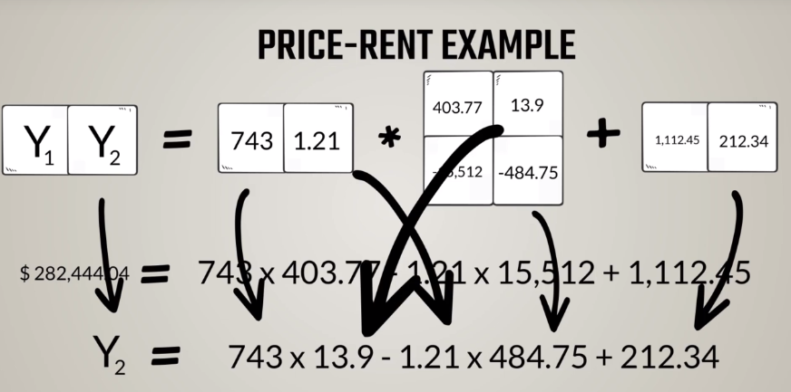

Slide 38
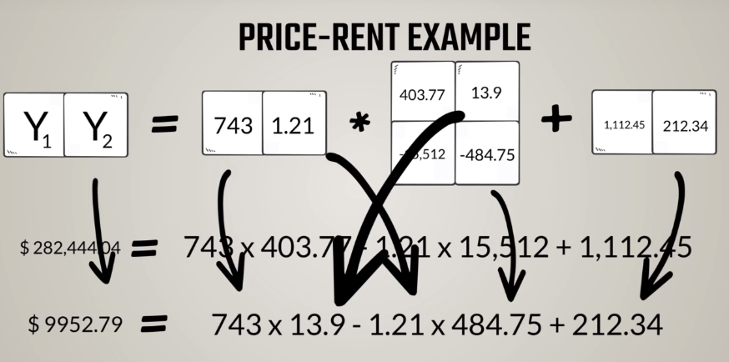

Slide 39
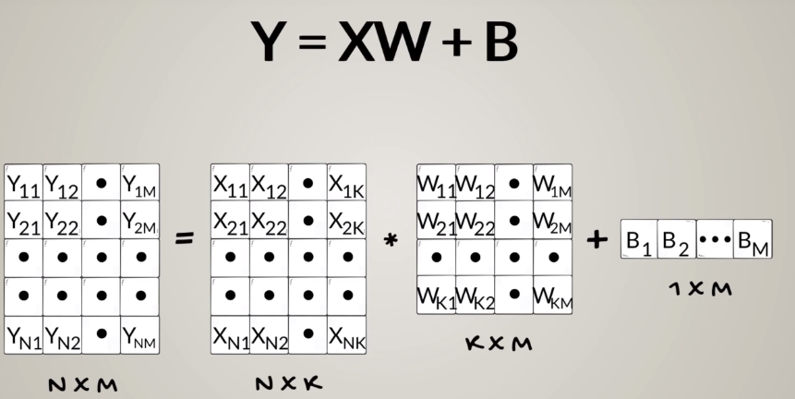

Slide 40
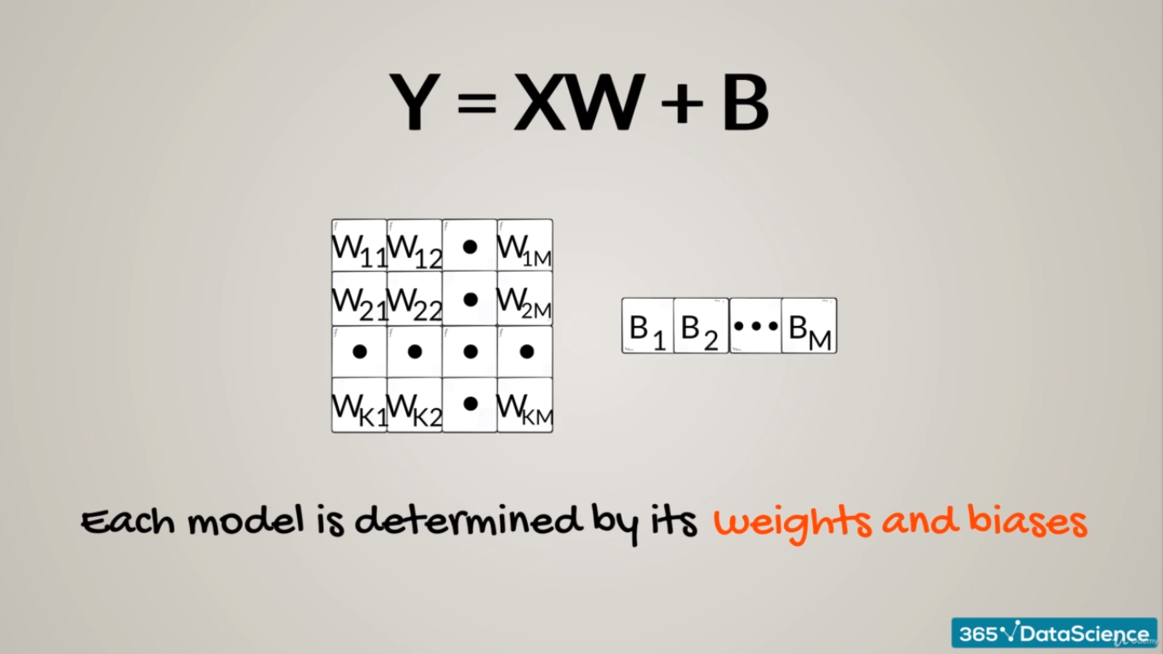

Slide 41
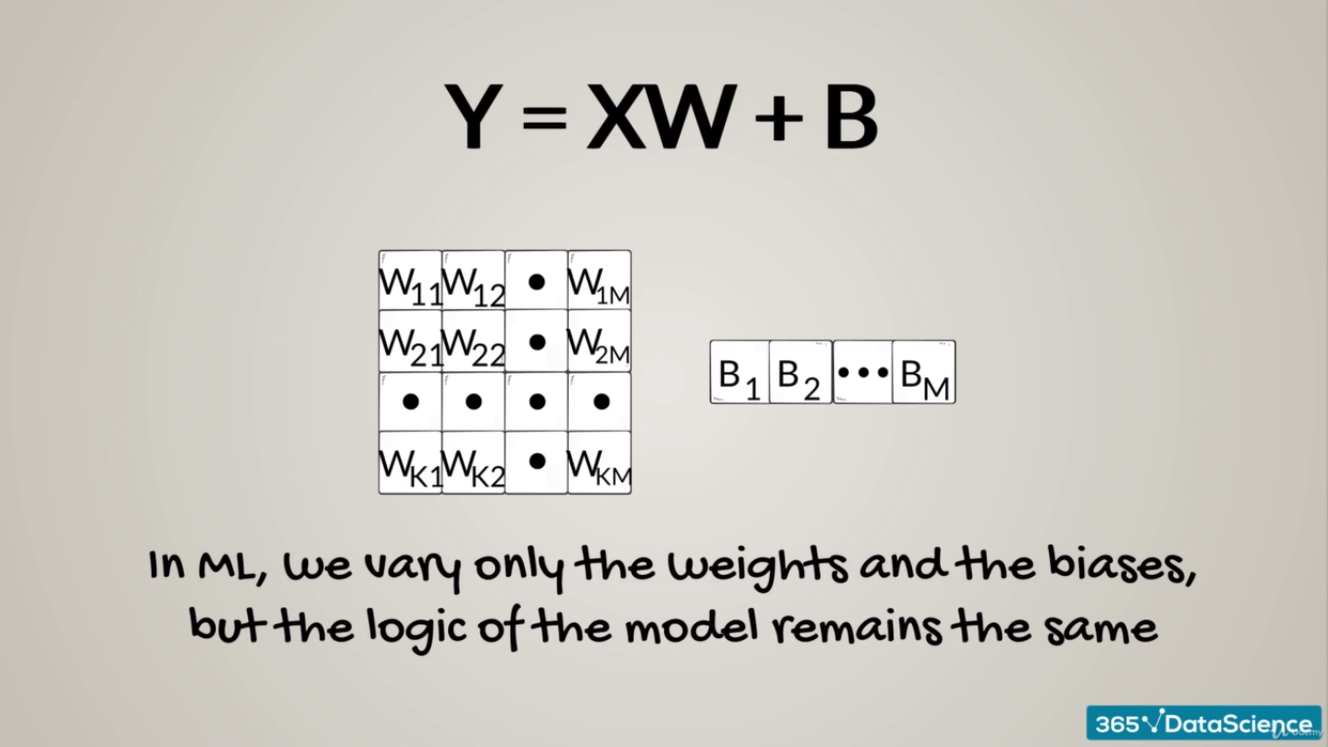

Slide 42

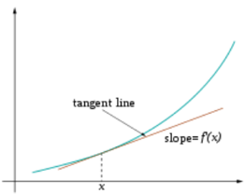
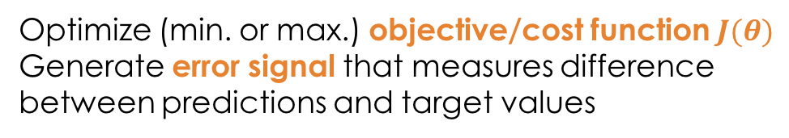
Training
Sample labeled data
(batch)
Forward it through the network, get predictions
Back-propagate the errors
Update the network weights
Optimize (min. or max.) objective/cost function $J(θ)$
Generate error signal that measures difference between predictions and target values
Use error signal to change the weights and get more accurate predictions
Subtracting a fraction of the gradient moves you towards the (local) minimum of the cost function
https://medium.com/@ramrajchandradevan/the-evolution-of-gradient-descend-optimization-algorithm-4106a6702d39

Slide 43
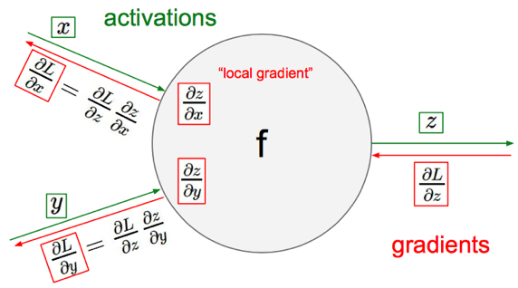
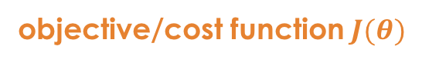
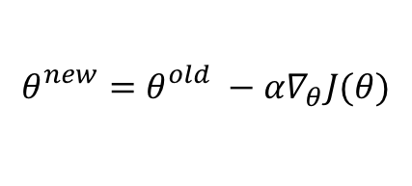
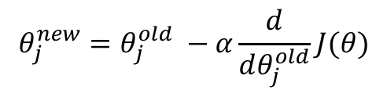
Gradient Descent
objective/cost function $J(θ)$
Review of backpropagation
$$θ_{j}^{new}=θ_{j}^{old} −α\frac{ⅆ}{ⅆθ_{j}^{old}}J(θ)$$
Update each element of θ
$$θ_{}^{new}=θ_{}^{old} −α∇_{θ}J(θ)$$
Matrix notation for all parameters
learning rate
Recursively apply chain rule though each node
Notes:
Adaptive Gradient Algorithm (AdaGrad) that maintains a per-parameter learning rate that improves performance on problems with sparse gradients (e.g. natural language and computer vision problems).
Root Mean Square Propagation (RMSProp) that also maintains per-parameter learning rates that are adapted based on the average of recent magnitudes of the gradients for the weight (e.g. how quickly it is changing). This means the algorithm does well on online and non-stationary problems (e.g. noisy).
Adam realizes the benefits of both AdaGrad and RMSProp.
Instead of adapting the parameter learning rates based on the average first moment (the mean) as in RMSProp, Adam also makes use of the average of the second moments of the gradients (the uncentered variance).
Specifically, the algorithm calculates an exponential moving average of the gradient and the squared gradient, and the parameters beta1 and beta2 control the decay rates of these moving averages.
The initial value of the moving averages and beta1 and beta2 values close to 1.0 (recommended) result in a bias of moment estimates towards zero. This bias is overcome by first calculating the biased estimates before then calculating bias-corrected estimates.

Slide 44
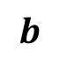

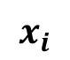
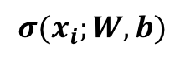
One forward pass
Text (input) representation
TFIDF
Word embeddings
….
0.2 | -0.5 | 0.1
2.0 | 1.5 | 1.3
0.5 | 0.0 | 0.25
-0.3 | 2.0 | 0.0
0.1
0.2
0.3
1.0
3.0
0.025
0.0
0.95
3.89
0.15
0.37
very positive
positive
negative
very negative
$$W$$
$$x_{i}$$
$$b$$
$$σ(x_{i};W, b)$$

Slide 45
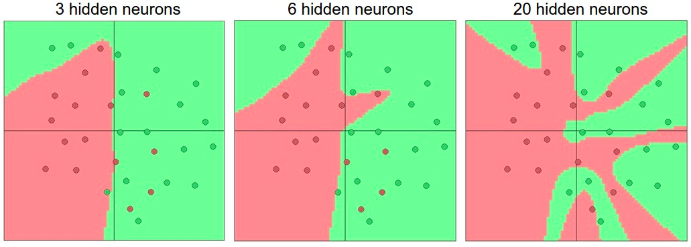

Activation functions
Non-linearities needed to learn complex (non-linear) representations of data, otherwise the NN would be just a linear function
More layers and neurons can approximate more complex functions
$W_{1}W_{2}x=Wx$
http://cs231n.github.io/assets/nn1/layer_sizes.jpeg
Full list: https://en.wikipedia.org/wiki/Activation_function

Slide 46


Activation: Sigmoid
Takes a real-valued number and “squashes” it into range between 0 and 1.
$$R^{n}→\left[0,1\right]$$
http://adilmoujahid.com/images/activation.png
Nice interpretation as the firing rate of a neuron
0 = not firing at all
1 = fully firing
Sigmoid neurons saturate and kill gradients, thus NN will barely learn
when the neuron’s activation are 0 or 1 (saturate)
gradient at these regions almost zero
almost no signal will flow to its weights
if initial weights are too large then most neurons would saturate

Slide 47



Activation: Tanh
Takes a real-valued number and “squashes” it into range between -1 and 1.
$$R^{n}→\left[−1,1\right]$$
http://adilmoujahid.com/images/activation.png
Like sigmoid, tanh neurons saturate
Unlike sigmoid, output is zero-centered
Tanh is a scaled sigmoid: $\tanh\left(x\right)=2sigm\left(2x\right)−1$
Notes:
not zero-centered: later layers of processing would be receiving data that is not zero-centered.
if data coming into a neuron is always positive then the gradient on the weights will be either all be positive, or all negative (depending on the gradient of the whole expression). Could introduce undesirable zig-zagging dynamics in the gradient weight updates. However, once these gradients are added up across a data batch the final weight update can have variable signs, somewhat mitigating this issue.

Slide 48



Activation: ReLU
Takes a real-valued number and thresholds it at zero
$$f\left(x\right)= max⁡(0,x)$$
$$R^{n}→R_{+}^{n}$$
http://adilmoujahid.com/images/activation.png
Most Deep Networks use ReLU nowadays
Trains much faster
accelerates the convergence of SGD
due to linear, non-saturating form
Less expensive operations
compared to sigmoid/tanh (exponentials etc.)
implemented by simply thresholding a matrix at zero
More expressive
Prevents the gradient vanishing problem
Notes:
ReLU units can “die”
large gradient flowing through a ReLU could cause weights to update in such a way that the neuron will never activate on any datapoint again
gradient flowing through the unit will forever be zero from that point on
With a proper setting of the learning rate this is less frequently an issue

Slide 49


Overfitting
http://wiki.bethanycrane.com/overfitting-of-data
Learned hypothesis may fit the training data very well, even outliers (noise) but fail to generalize to new examples (test data)
https://www.neuraldesigner.com/images/learning/selection_error.svg

Slide 50


Regularization
Dropout
Randomly drop units (along with their connections) during training
Each unit retained with fixed probability p, independent of other units
Hyper-parameter p to be chosen (tuned)
Srivastava, Nitish, et al. "Dropout: a simple way to prevent neural networks from overfitting." Journal of machine learning research (2014)
L2 = weight decay
Regularization term that penalizes big weights, added to the objective
Weight decay value determines how dominant regularization is during gradient computation
Big weight decay coefficient → big penalty for big weights
$$J_{reg}\left(θ\right)= J\left(θ\right)+λ\sum_{k}{θ_{k}^{2}}$$
Early-stopping
Use validation error to decide when to stop training
Stop when monitored quantity has not improved after n subsequent epochs
n is called patience

Slide 51

Tuning hyper-parameters
g(x) ≈ g(x) + h(y)
g(x) shown in green
h(y) is shown in yellow
Bergstra, James, and Yoshua Bengio. "Random search for hyper-parameter optimization." Journal of Machine Learning Research, Feb (2012)
“Grid and random search of 9 trials for optimizing function g(x) ≈ g(x) + h(y)
With grid search, nine trials only test g(x) in three distinct places.
With random search, all nine trials explore distinct values of g. ”
Both try configurations randomly and blindly
Next trial is independent to all the trials done before
Bayesian optimization for hyper-parameter tuning:
Make smarter choice for the next trial, minimize the number of trials
Collect the performance at several configurations
Make inference and decide what configuration to try next
Library available!

Slide 52





Loss functions and output
Classification
Regression
Training
examples
R^{n} x {class_1, ..., class_n}
(one-hot encoding)
R^{n} x R^{m}
Output
Layer
Soft-max
[map R^{n} to a probability distribution]
Linear (Identity)
or Sigmoid
f(x)=x
Cost (loss)
function
Cross-entropy
Mean Squared Error
$$J\left(θ\right)= \frac{1}{n}\sum_{i=1}^{n}{{\left(y^{(i)}−{\hat{y}}^{(i)}\right)}^{2}}$$
$$J\left(θ\right)=−\frac{1}{n}\sum_{i=1}^{n}{\sum_{k=1}^{K}{\left[y_{k}^{(i)}\log{{\hat{y}}_{k}^{(i)}+\left(1−y_{k}^{(i)}\right) }\log\left(1− {\hat{y}}_{k}^{\left(i\right)}\right)\right]}}$$
Mean Absolute Error
$$J\left(θ\right)= \frac{1}{n}\sum_{i=1}^{n}{\left|y^{(i)}−{\hat{y}}^{(i)}\right|}$$
List of loss functions
Notes:
Exponentiate to make it positive
MSE has nice mathematical properties which makes it easier to compute the gradient
Because of the square, large errors have relatively greater influence on MSE.
Therefore, MAE is more robust to outliers since it does not make use of square.

Slide 53



Convolutional Neural Networks (CNNs)
Main CNN idea for text:
Compute vectors for n-grams and group them afterwards
Example: “this takes too long” compute vectors for:
This takes, takes too, too long, this takes too, takes too long, this takes too long
Convolutional
3x3 filter
Input matrix
http://deeplearning.stanford.edu/wiki/index.php/Feature_extraction_using_convolution
Notes:
http://www.asimovinstitute.org/neural-network-zoo/

Slide 54

Convolutional Neural Networks (CNNs)
Main CNN idea for text:
Compute vectors for n-grams and group them afterwards
max pool
2x2 filters
and stride 2
https://shafeentejani.github.io/assets/images/pooling.gif

Slide 55

CNN for text classification
Severyn, Aliaksei, and Alessandro Moschitti. "UNITN: Training Deep Convolutional Neural Network for Twitter Sentiment Classification." SemEval@ NAACL-HLT. 2015.
Notes:
the width m of the convolution filters is set to 5
n = 300 feature maps
first layer embeds words into low-dimensional vectors.

Slide 56

CNN with multiple filters
Kim, Y. “Convolutional Neural Networks for Sentence Classification”, EMNLP (2014)
sliding over 3, 4 or 5 words at a time

Slide 57





Recurrent Neural Networks (RNNs)
Main RNN idea for text:
Condition on all previous words
Use same set of weights at all time steps
$$h_{t}= σ(W^{(hh)}h_{t−1}+W^{(hx)}x_{t})$$
$$≜$$
https://pbs.twimg.com/media/C2j-8j5UsAACgEK.jpg
Stack them up, Lego fun!
Vanishing gradient problem
https://discuss.pytorch.org/uploads/default/original/1X/6415da0424dd66f2f5b134709b92baa59e604c55.jpg
Notes:
https://pbs.twimg.com/media/C2j-8j5UsAACgEK.jpg

Slide 58





Bidirectional RNNs
Main idea: incorporate both left and right context
output may not only depend on the previous elements in the sequence, but also future elements.
$${\overset{⃑}{h}}_{t}= σ({\overset{⃑}{W}}^{(hh)}{\overset{⃑}{h}}_{t−1}+{\overset{⃑}{W}}^{(hx)}x_{t})$$
$${\overset{⃖}{h}}_{t}= σ({\overset{⃖}{W}}^{(hh)}{\overset{⃖}{h}}_{t+1}+{\overset{⃖}{W}}^{(hx)}x_{t})$$
$$y_{t}=f\left( \left[{\overset{⃑}{h}}_{t}{;\overset{⃖}{h}}_{t}\right] \right)$$
past and future around a single token
http://www.wildml.com/2015/09/recurrent-neural-networks-tutorial-part-1-introduction-to-rnns/
two RNNs stacked on top of each other
output is computed based on the hidden state of both RNNs $\left[{\overset{⃑}{h}}_{t}{;\overset{⃖}{h}}_{t}\right]$

Slide 59

https://giphy.com/gifs/thanks-thank-you-thnx-3o6ozuHcxTtVWJJn32/download

